Slide 1
Prediction of antibiotic resistance in Escherichia coli from large-scale pan-genome data
Group - | BIO543 - Big Data Mining in Healthcare
Group Members:
Mannika Garg | 2016161
Raj Kamal Yadav | 2016076
Rajat Bansal | 2016260
Shailja Bhatt | 2016192

Slide 2

INTRODUCTION
Antibiotic resistance among bacteria poses a major threat of potentially incurable outbreaks.
Traditional culture-based methods have proven
to be time consuming and require prior
knowledge of biological mechanisms.
It is essential to have a quick, cheap and reliable
detection mechanism for the presence or
absence of drug-resistant bacteria.

Slide 3
EXISTING METHODS
Culture based laboratory tests - Costly and time-consuming
Genetic test -
Affordable and accurate owing to the higher availability of genome sequencing data from clinical strains
Provide fast diagnosis
However, can only be used to detect resistance caused by known pathogens with well-defined resistance mechanisms

Slide 4
PROBLEM STATEMENT
We aim to achieve the best machine learning model for the detection of drug-resistance to 11 antibiotic compounds in 1936 Escherichia coli stain from large-scale pan-genome data. We have compared four models: Random Forests, Gradient Boosted Classifiers, X Gradient Boosted Classifiers and Deep Neural Networks with the conventional rule-based approach.

Slide 5
DATASET
The antibiotic components are -
AMP (ampicillin)
CXM (cefuroxime)
CTX (cefotaxime)
CET (cephalothin)
CTZ (ceftazidime)
GEN (gentamicin),
TBM (tobramycin)
CIP (ciprofloxacin)
AMC (amoxicillin-clavulanate)
AMX (amoxicillin)
TMP (trimethoprim).
1936 E.coli strains
Antimicrobial susceptibility test
for 11 antibiotic sequence
Labeled :
S - Susceptible, R - Resistant
Pan genome sequence using paired end reads

Slide 6
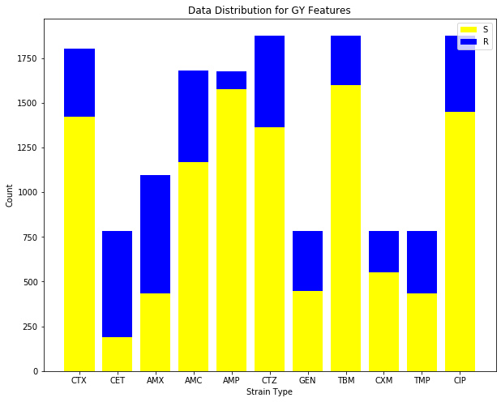
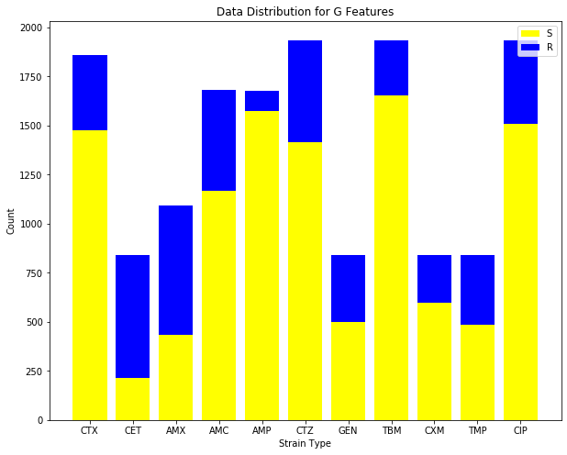
For each input feature and drug, it can be seen that the count of Susceptible strains(S) in the dataset is much more than Resistant strains(R).

Slide 7
Data Cleaning and Preprocessing
Remove constant features (Zero Variation)
Features that contain only one value for all outputs in the dataset.
Remove Quasi-Constant Features (< 0.1 variation)
Features that are almost constant, that have more than 99 percent similar values for the output observations.
Remove correlated features (threshold= 0.95)
Features are correlated if they are close to each other in the linear space.
Principal Component Analysis
Dimensionality reduction technique to increase interpretability but at the same time minimize information loss.

Slide 8
Input Features consist of three main components:-
Accessory gene matrix (G)
Population structure (P)
Year of isolation (Y)
Total number of features - 17200(GY) and 17199(G) and 17727(GYS)
Cleaned Data has features - 3833(GY)
Cleaned Data has features - 6965(GYS)
Cleaned Data has features - 6002(G)
Split the dataset into 2:8 for testing and training to have make results comparable with those in the paper

Slide 9
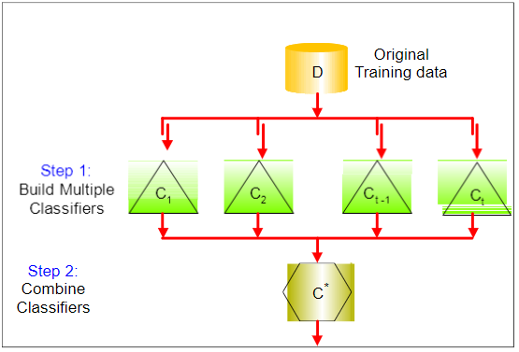
VotingClassifier -- An improved model!
Models using Voting Classifier:
Random Forest
Gradient Boosting Classifier

Slide 10
METHODS
Random Forest Classifier
Voting consists of 3
Random Forest Classifiers
Hard voting criteria
N_estimators = 1000, 1200, 1500
Feature Matrix : GY
Gradient boosted decision tree
Voting consisting of 3
Gradient boosting classifiers
Hard voting criteria
n_estimators= 300, 310, 320
Feature Matrix : GY
Deep Neural Networks
No. of Neurons = 200 - 600
Layers = 2-6
Dimensionality Reduced(PCA)
Feature Matrix : G
X Gradient boosted decision Tree
Dimensionality Reduced(PCA)
Learning Rate =0.1
n_estimators= 500
Feature Matrix : GYS

Slide 11
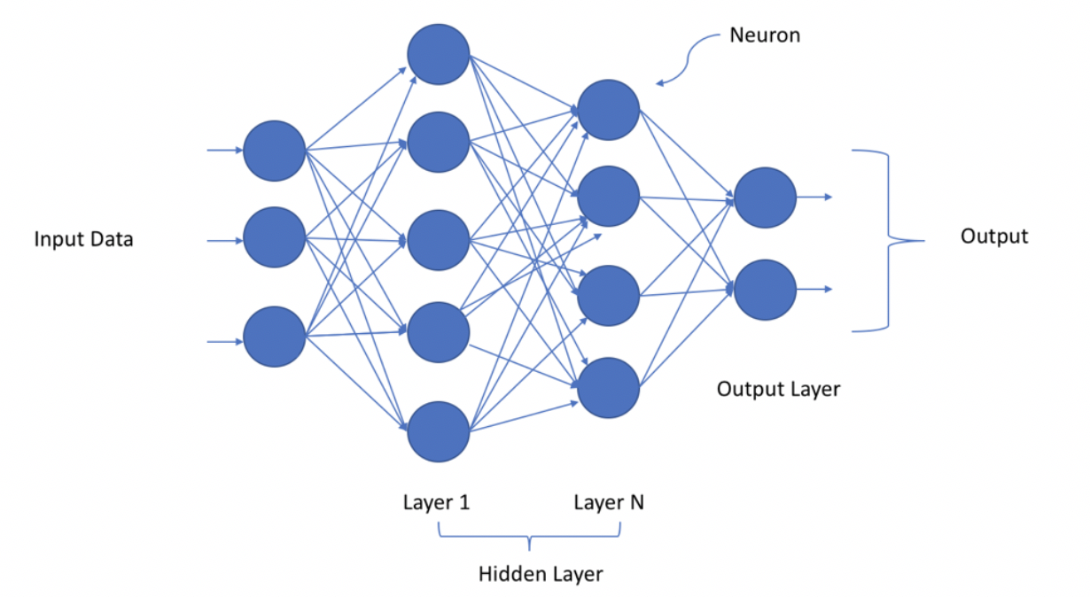
Deep neural network
Deep Learning Models are applied
Value 1 | Layers
AMC | (200,100)
AMP | (400,150,150)
AMX | (400,200,200,200,200,200,200)
CET | (600,150,150,150)
CIP | (400,150)
CTX | (600,150,150,150)
CTZ | (200,150,150,150,150,150)
CXM | (600,100)
GEN | (600,100)
TBM | (400,150,150,150,150,150)
TMP | (600,150,150,150,150,150)

Slide 12
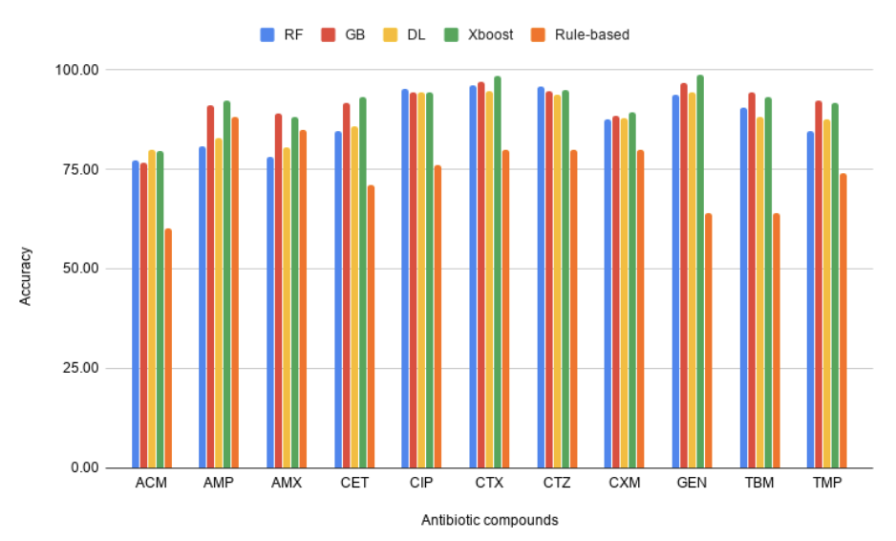
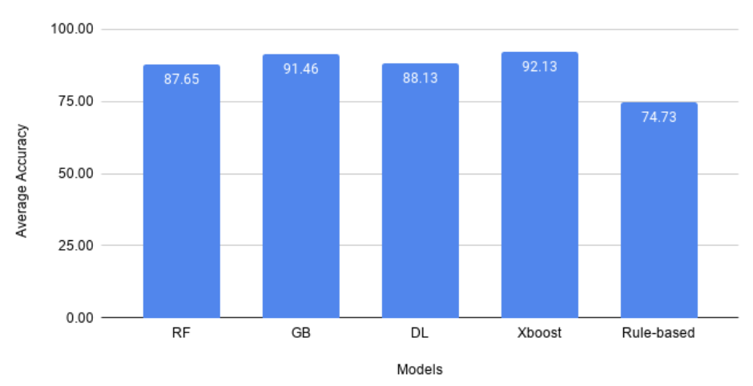
RESULTS
Fig.1. Accuracy Comparison Fig.2. Average Accuracy Comparison
Accuracy achieved by the proposed models > rule based approach
The best results : GY dataset for Random forest model, Gradient boosting model and X Gradient boosting model, and G dataset for Deep Learning

Slide 13
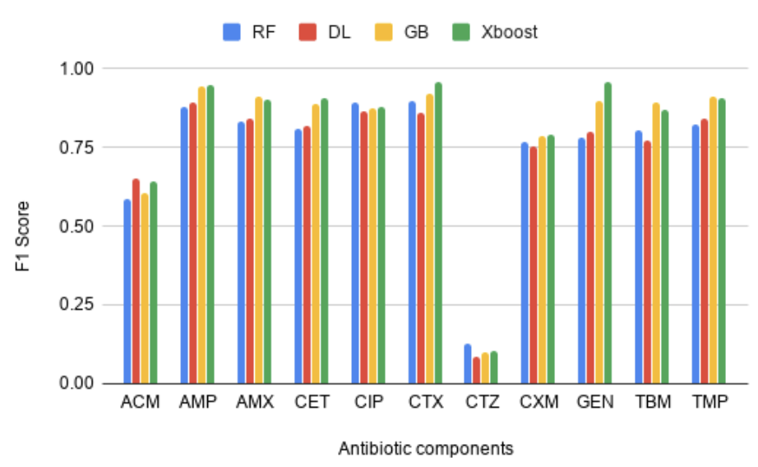
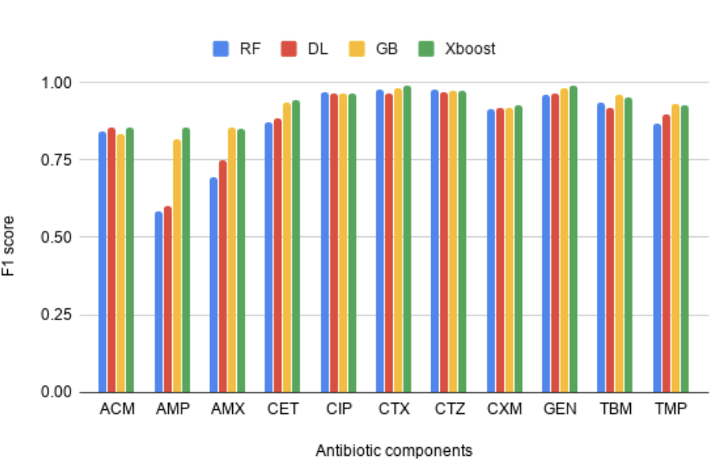
Our models are not suitable for the detection in the case of CTZ as the F1 score for resistance from CTZ is low (Fig. 4).
Fig.3. F1 Score for Resistance Fig.4. F1 score for Susceptibility

Slide 14
X Gradient boosting :
Best model for detection of drug resistant bacteria (highest avg. F1 score for Resistance and Susceptibility)
Outperforms all the other models for 6/11 drugs (AMP, CET, CTX,CXM, GEN, TMP)
Value 1 | RF | DL | GB | Xboost
Resistance | 0.74 | 0.74 | 0.79 | 0.81
Susceptibility | 0.87 | 0.88 | 0.92 | 0.93
Average F1 score

Slide 15
CONCLUSION
Accessory genes are sufficient to achieve decent accuracy, but the addition of year of isolation to the feature vector has improved the accuracy by an average of 1.3% for Random forest and gradient boosting models.
Population structure matrix as input feature vector has offered an accuracy of 72%.
Machine learning approaches are better than the clinical procedure to detect drug resistance.
X Gradient boosting offered the best accuracy among all the other models.

